Slide 1


Don’t rely on lead-acid batteries to start your engines.
December 2018
Rev A.1

Slide 2

Batteries will fail. Their end-of-life is inevitable .
Dead batteries are a simple fact of life when it comes to boat operation and ownership. Long periods of disuse, temperature extremes, corrosion, shock and vibration all take their toll on your engine’s cranking battery. Unlike a car, jump starting a boat isn’t easy, it usually requires especially long and heavy jumper cables, finding and hooking up a battery charger or removing the battery and taking it someplace where it can be charged and the danger of jump starting batteries, with the potential for an explosion, is well documented.

Slide 3

KAPower is not a battery. KAPower is a Electrochemical Double Layer Capacitor.
With KBI’s range of specialized engine starting products, however, that equation has changed forever. Using either the permanently installed KAPower Starting Module (KSM), or the portable KrankingKART Mini HD, it’s now possible to have onboard, reliable back-up reserve starting power that’s always there when needed. Unlike lead acid batteries, KBI products rely on supercapacitors, also known as ultracapacitors.

Slide 4

So what does this mean to the boat or the boat builder?
The KSM Supercapacitor module is powerful enough to supply cranking power without the use of lead-acid batteries.
Available as a 12 or 24-volt module, one module can provide 24 volts - no need to series modules (batteries).
One module is all that’s need to start several engines - eliminate multiple battery banks.
It is truly maintenance free and will last the life of the vessel.
No gassing, no ventilation required. Can be installed in virtually any orientation.
It can be installed in remote locations, not needing access for change-out like the batteries do.
It will provide weight savings and space savings.
When isolated it will retain sufficient charge for engine cranking for extended periods of time.
It can be recharged almost instantaneously (within seconds) if need be off the house batteries or any other DC power source.

Slide 5
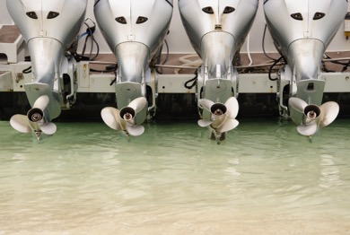
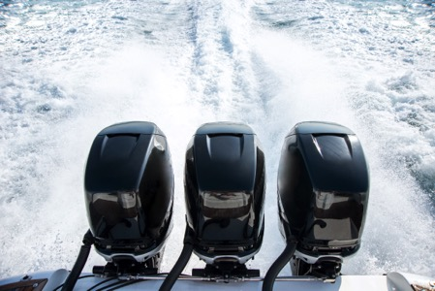
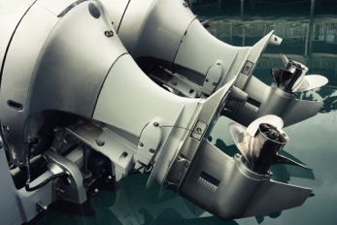
Inboard or outboard applications, not every engine would require its own set of batteries for engine starting events.
One KSM could provide starting assistance to several start batteries.

Slide 6

“Once installed it’s like having an emergency battery permanently on standby without any of the maintenance an actual battery requires.”
Installation for the KSM is straightforward, its stainless steel enclosure is lightweight, the heaviest model, which supplies 112 kW, weighs only 32.5 pounds (14.7 kg); it can be mounted in any orientation, even upside down.

Slide 7
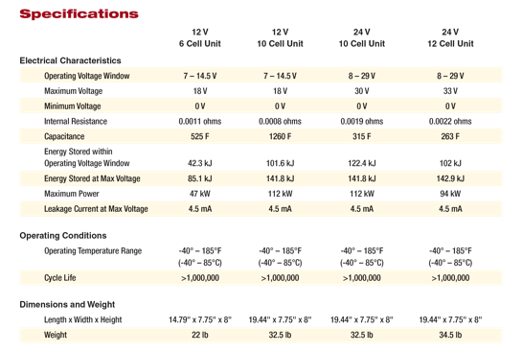
KSM specifications for every application.
The KSM is available in 12 and 24 volts, and several capacity ranges. All units recharge after use in a scant 30 seconds.

Slide 8

Some background on KBI:
While KSM is a relative newcomer to the marine market, we’ve been in the engine starting business for over half a century, selling primarily to some of the harshest applications in the world, including commercial, military and over the road transport vehicles.

Slide 9


Over twenty years experience with supercapacitors for starting engines.
We are working with marine OEMs but none have gone “public” yet. Again we’re new to the industry but the KSM and our experience is not new. We have been applying supercapacitor engine starting technology for over twenty years. We are American Boat and Yacht Council members and KBI Engineering expects to have certified staff members in the near future.

Slide 10
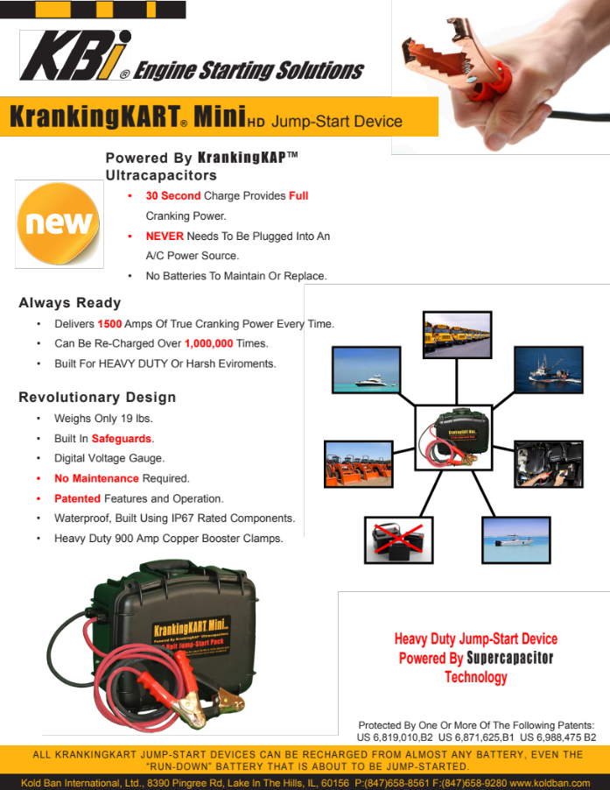
The portable KrankingKART Mini HD, also uses supercapacitor technology.
The first and only jump-start pack made specifically for the Marine Market, the Mini HD is a portable start pack that is housed in a rugged ABS plastic case, which is waterproof to IP 67 standards, it even floats.
With its digital volt meter, 1,500 amp output, built in reverse polarity protection, 6 foot long cables and heavy duty copper clamps, it’s designed for operation in the toughest jump starting environments.

Slide 11

More customer testimonials.
The Mini HD will outlast conventional jump-start devices several times over.

Slide 12

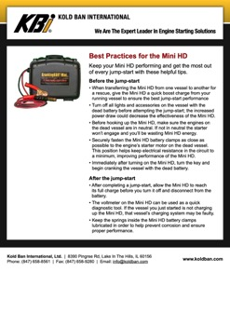




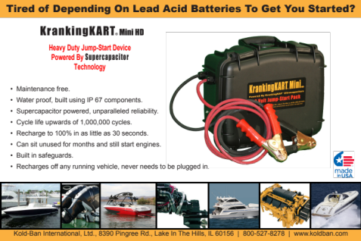
Visit http://www.marxgold.com/
For copies of all literature and details.
Contact our Australian Distributor
Marxgold Starting Solutions
Mark Bygrave: sales@marxgold.com
Director
44 Berallan Drive,
Tinana, QLD, 4650, AUSTRALA
PH: 0428198423

Slide 13

KBI is proud to be a part of the Marine Industry. KBI will continue to develop and supply superior products which will enhance our customers’ product performance and reliability.
For sales in Australia contact
Marxgold Starting Solutions, 44 Berallan Drive Tinana QLD, sales@marxgold.com, www.marxgold.com
0428198423
KBI / Kold-Ban International, Ltd. 8390 Pingree Road, Lake In The Hills, Illinois, 60156-9637 USA
Telephone (800) 527-8278 or (847) 658-8561. Fax (847) 658-9280. World Wide Web at WWW.koldban.com

